Slide 1


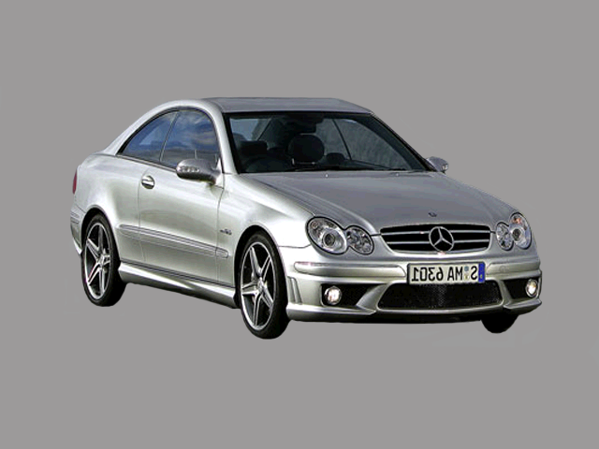
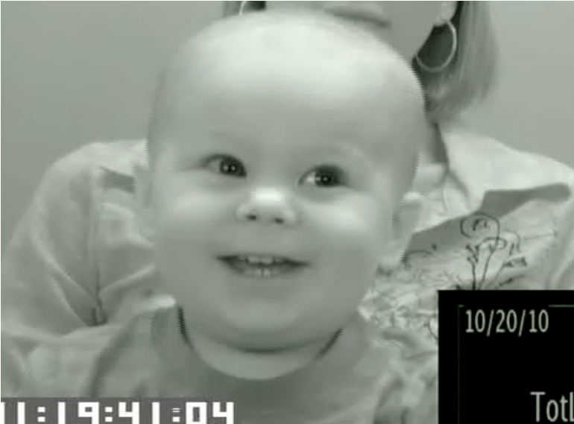
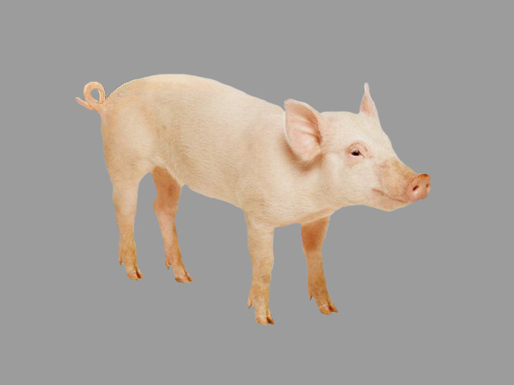

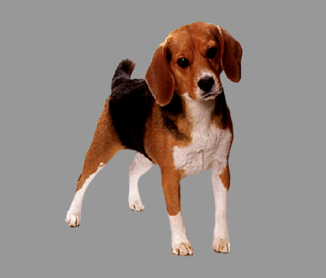
I went to the garage, and I saw a pig:
Information about location guides 30-month-olds’ attention to unnamed objects
Ricardo Bion & Anne Fernald – ricardoh@stanford.edu
Center for Infant Studies
Introduction
Children's speed at processing familiar words is related to concurrent vocabulary size and later cognitive development (Fernald et al., 2006)
But words are rarely heard in isolation, and since related words often co-occur in language, it is important to understanding how children can use semantic relations to speed-up language processing
It is an open question whether variability in children's efficiency in relying on their existing semantic network to identify familiar objects is related to other measures of language proficiency
A possible cue children might use to identify a familiar object is the name of a location, a cue that speeds-up word recognition in adults – they are faster to recognize the name of an object when it is preceded by the location in which it is found, e.g., GARAGE->CAR (Hare et al., 2009)
Stimuli
Block of 12 Location-Congruent Trials:
Block of 12 Location-Incongruent Trials:
I went to the GARAGE, and I saw a CAR
I went to the FARM, and I saw a CAR
Results RQ1
I went to the GARAGE and I saw a CAR
Participants
I went to the FARM and I saw a CAR
% looking to
target object
Location-Congruent
Location-Incongruent
Research Questions
RQ1: Are young children able to use the name of a location to restrict the domain of upcoming familiar referents?
RQ2: If so, is this skill related to children's concurrent vocabulary?
RQ1: Young children are able to use the name of a location to restrict the domain of an upcoming referent.
Results RQ2
Discussion and current studies
Participants
Children's ability to rely on the name of a location to guide their attention to a familiar object was highly correlated to their concurrent vocabulary
This ability to "listen predictively" might free cognitive resouces for children to encode upcoming linguistic input
These findings could be explained by priming between locations and objects (Hare et al., 2009), event-based knowledge (McRae et al., 2006), or inferences based on object affordances
We are currently investigating whether children can also relate on the name of an object to chose between the pictures of two familiar locations
Another study is focusing on whether these kinds of inferences could be used to disambiguate the referent of novel words
Twenty-five 30-month-olds
Location-Congruent
Location-Incongruent
r (23) = 0.726, p < 0.001
Method
Looking-while-listening (LWL) task: Children look at two pictures while hearing a sentence naming one of the pictures. Gaze patterns are videorecorded and eye movements are coded offline.
Accuracy: proportion looking to the target vs. distracter
MacArthur-Bates Communicative Development Inventory (W&S):
r (23) = 0.178, p = 0.395
RQ 2: Anticipation on the location-congruent block is strongly correlated to vocabulary

